Slide 1
Analysis of Portuguese Banking Institution's Direct Marketing Campaigns:
CIND 820 - Big Data Analytics Project – D1H
Predictive Modeling and Strategy Enhancement
Supervisor: Ceni Babaoglu, Ph.D.
Student: Isolda Veruska de Almirante Silva
Student ID: 501241365

Slide 2
Outline
Introduction
Research Questions
Dataset and Approach
Models
Conclusion
References

Slide 3
Introduction
Telemarketing employs phone calls for diverse functions, including product promotion and customer support.
Within the banking sector, marketing plays a crucial role by utilizing extensive customer data to create personalized campaigns and improving telemarketing strategies through thorough data analysis.
Data science employs statistical, AI, and machine learning techniques, focusing on tasks like classification with methods such as Naïve Bayes and neural networks.

Slide 4
Research Questions
By applying data science principles to a bank telemarketing dataset, the researcher aims to understand:
What drives clients to subscribe to a term deposit in this campaign?
Can we build accurate predictive models from the data?
How we can improve marketing campaigns?

Slide 5
Dataset and Approach
Dataset from a Portuguese banking institution's direct marketing campaigns available in the UC Irvine website, primarily conducted via phone calls.
Link: http://archive.ics.uci.edu/dataset/222/bank+marketing
Full dataset : 45,211 records, with 16 input attributes and one output attribute ('y')

Slide 6
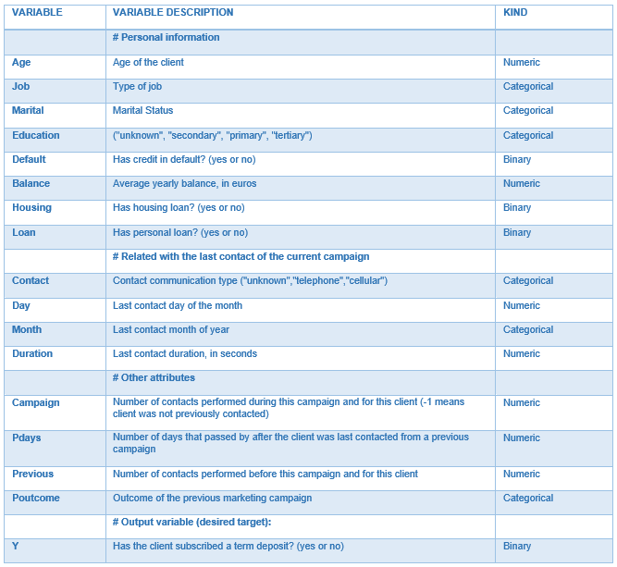
Dataset and Approach
Data Integrity Check: No missing or duplicate data
Binary Data Transformation: 'Yes/No' data was converted into Boolean values.
Numerical Feature Analysis: Descriptive statistical analysis was conducted on numerical variables to understand their distribution.
Categorical Variable Restructuring: Certain variables were restructured into distinct categories.
Dummy Variable Conversion: All categorical variables were converted into dummy variables (one-hot encoding).

Slide 7
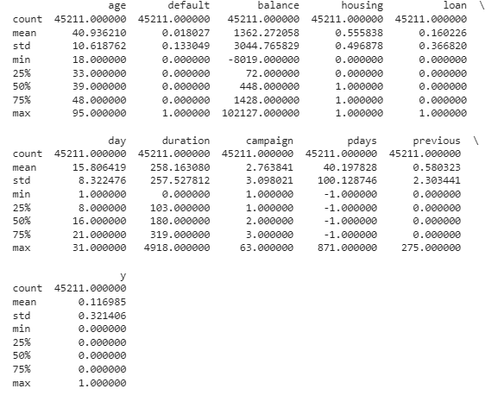
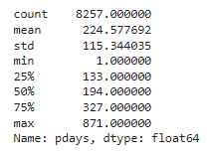
Dataset and Approach Univariate Analysis
Numerical Descriptive Statistics:
Mean age of customers is approximately 40.94 years, ranging from 18 to 95.
Most customers have no default history (mean ≈ 0.018).
Balance ranges from negative €8k to over €100k (mean ≈ €1,362.27).
About 56% have housing loans; around 16% have personal loans.
Call durations vary from 0 to 4,918 seconds (mean ≈ 258.16).
Campaign contact count ranges from 1 to 63 (mean ≈ 2.76).
Days since the last contact range from -1 to 871 days (mean ≈ 40.20).
Number of previous contacts ranges from 0 to 275 (mean ≈ 0.58).
Target variable "y" is binary, with "0" indicating "no" and "1" indicating "yes."
Notes:
Outliers such as €100k contributing to a mean greater than the median signify that the distribution of balance amounts is positively skewed (right-tailed)
For days since the last contact range, the “-1” value means there was never a previous contact

Slide 8
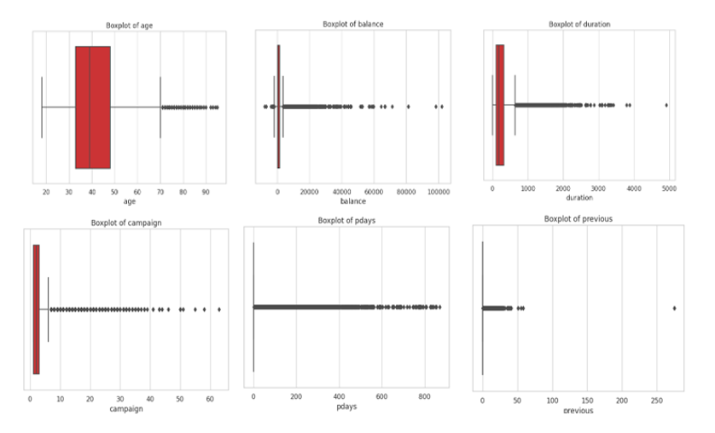
Dataset and Approach Outliers
Identification: Outliers were detected in variables like 'age,' 'balance,' 'duration,' 'campaign,' 'pdays,' and 'previous’.
Outlier Handling: A grouping approach was chosen to manage outlier values instead of removing them
Notes:
Example: age was broken down into the following groups: 18~24, 25~34, 35~44, 45~59, 60+

Slide 9
Dataset and Approach Categorical and Boolean Variables Analysis
Majority of clients have some level of educational attainment, with secondary education prevalent.
Campaign contacts were often made via clients' mobile phones.
Management, technician and blue-collar were the most popular jobs.
May stands out as the peak month for campaign outreach.
Previous campaign outcomes are largely marked as "unknown."
Variables 'job,' 'education,' and 'contact' contain "unknown" values.
Majority of clients are married, followed by unmarried and divorced individuals.

Slide 10
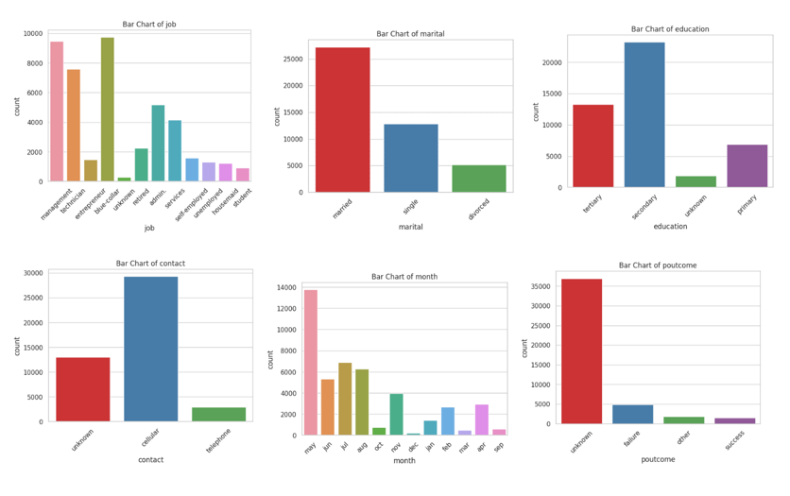
Dataset and Approach Categorical and Boolean Variables Analysis

Slide 11
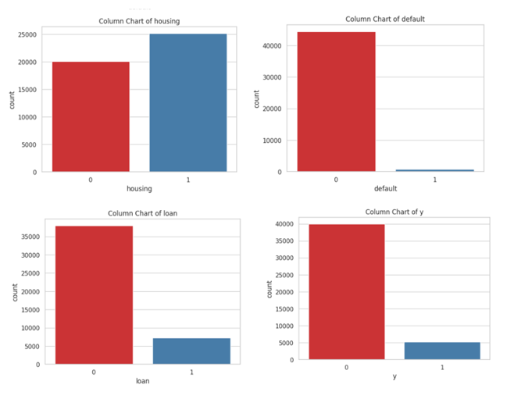
Dataset and Approach Categorical and Boolean Variables Analysis
Three out of four Boolean variables, including the target variable "y," show significant imbalances.
Around 11% of the individuals who took part in the campaign subscribed to the product.
Around 56% of clients have housing loans, approximately 16% have personal loans, and about 2% have a credit default.

Slide 12
Dataset and Approach Bivariate Analysis
Correlation Matrix Findings:
Primary education showed a positive correlation with manual labor.
Positive correlation observed between younger age group and student status, as well as the oldest age group and retirement.
Correlation between the success of the previous campaign and the current one, as well as age groups 18-24 and 60+.
Call duration correlated with campaign success, with shorter calls negatively correlated and medium-duration calls positively correlated.
Recent client contact associated with more successful outcomes in the previous campaign.
Variable Selection Decisions:
Dropped variable groups: 'job type,' 'marital status,' and 'months.'
Dropped 'pdays_interval_-1 ~ 0' due to perfect correlation with 'poutcome_unknown.'
Notes:
Dropped variable groups: 'job type,' 'marital status,' and 'months.'
'Job type' dropped due to redundancy captured by 'age' and 'education.'
'Marital status' dropped due to strong correlations with 'age.'
'Months' dropped due to strong correlation with 'housing' status.
Dropped 'pdays_interval_-1 ~ 0' due to perfect correlation with 'poutcome_unknown.'

Slide 13
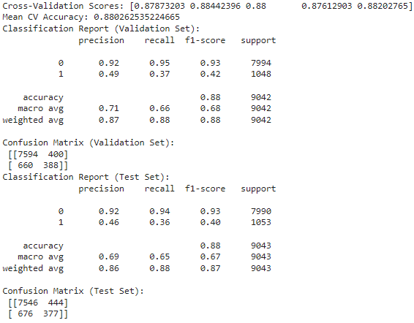
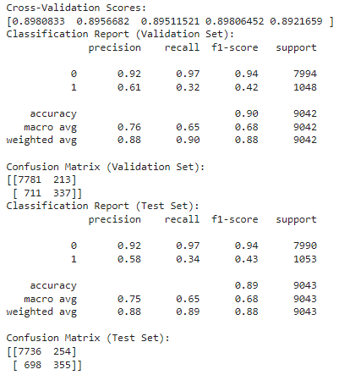
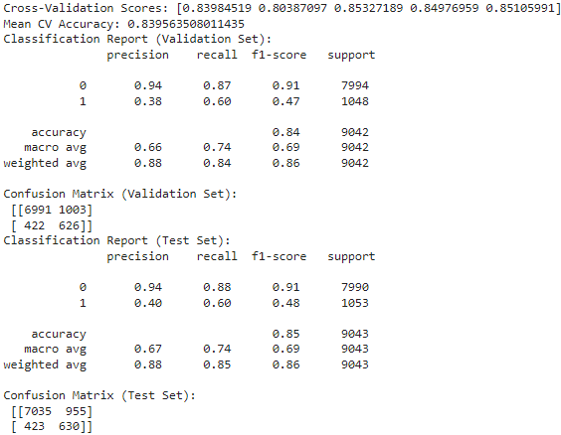
Model Selection Baseline Models
Random Forest, with similar accuracy, slightly improves recall for class 1 compared to Logistic Regression.
Three baseline models were used: Logistic Regression, Random Forest, and Naïve Bayes.
Employed cross-validation to assess model performance by splitting the dataset into subsets for robust evaluation.
Evaluation metrics: accuracy and recall.
Logistic Regression achieves around 89% accuracy but exhibits a lower recall for class 1.
Naïve Bayes has higher recall for class 1, prioritizing effective identification of campaign subscribers, albeit with a slightly lower accuracy.
Notes:
For our case, because we have an unbalanced target variable, our focus should be on recall more than on accuracy

Slide 14
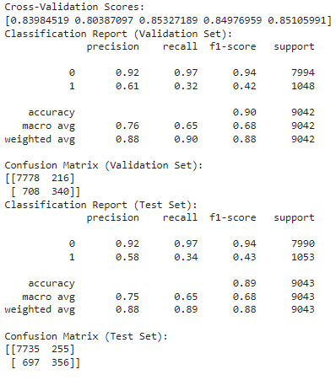
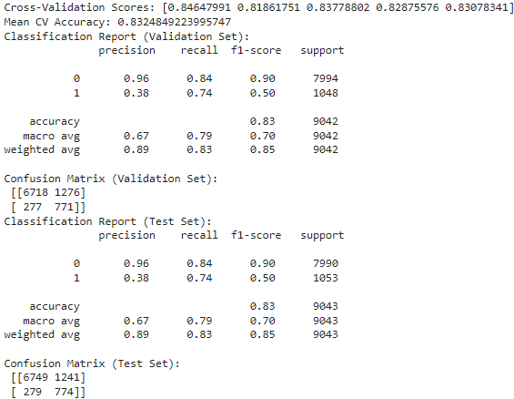
Model Selection Hyperparameter Tuning
Logistic Regression Model:
Tuning 'C' hyperparameter via grid search (values: 0.001, 0.01, 0.1, 1, 10, 100).
After tuning, recall for class 1 remained consistent at 32% on the validation set and 34% on the test set.
Other metrics (precision, f1-score, accuracy) showed no significant change.
Random Forest Model:
Defined hyperparameter grid (estimators, tree depth, splitting criterion, class weights).
Before tuning: 88% average accuracy, 37% recall for class 1 (validation), 35% recall for class 1 (test).
After tuning: 83% average accuracy, but recall for class 1 improved to 74% in both validation and test sets.
Notes:
Grid Search is a technique used in machine learning to optimize a model's hyperparameters.
The idea behind Grid Search is to create a "grid" of possible combinations of values for different hyperparameters and evaluate the model's performance for each combination.
It tests all possible combinations of hyperparameters within a predefined space.

Slide 15
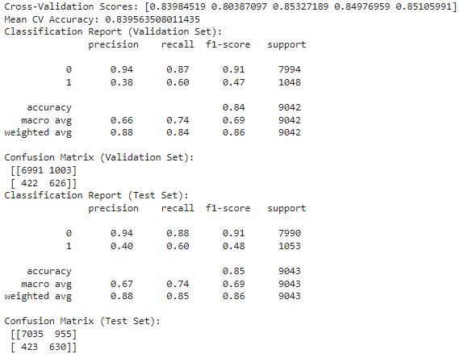
Model Selection Hyperparameter Tuning
Naïve Bayes Model:
Adjusted "priors" hyperparameter, representing a priori probability of each class.
Before tuning: 84% average accuracy, 60% recall for class 1 (validation and test).
After tuning: No impact on recall for class 1, with accuracy remaining around 84%.
Overall Result after Hyperparameter Tuning:
Random Forest model achieved the best result with a recall of 74% for class 1.

Slide 16
Model Comparison
The Random Forest model post hyperparameter tuning resulted in a recall of 74% for class 1.
The work in question, inspired by previous studies that employed data mining and models for predictive analysis, followed a similar approach. Using models studied throughout the course, the research aimed to achieve effective predictive analyses, with a focus on obtaining favorable results in recall and accuracy.
The choice of these models sought to replicate the successful predictive analysis observed in previous studies using more popular models.

Slide 17
Conclusion
Naïve Bayes initially outperformed, with class 1 recall reaching 60%.
Following hyperparameter tuning, Random Forest achieved the highest class 1 recall (74%), surpassing Logistic Regression (34%) and Naïve Bayes (60%).
Random Forest post hyperparameter tuning turned out to be the best overall model considering the importance of recall for this analysis. In imbalanced class scenarios, prioritizing recall is essential for accurately identifying instances from the minority class.
Project Impact and Opportunities:
Application of data mining, Python, and machine learning to address a business problem.
Possibility of exploring more machine learning models and hybrid classification methods for further refinement.
Findings and Recommendations:
Significant uptake of long-term deposits among specific demographic groups: young students (18-24) and retirees (60+). Recommendation to target telemarketing campaigns towards these groups or create exclusive products tailored to their needs.
Positive correlation observed between medium-duration calls and campaign success. Negative correlations in short calls (call rejections) and long calls (potential lack of employee skills selling products). Suggestion for improved employee training to enhance product explanation skills.
Clients contacted more recently since the previous campaigns linked to more successful outcomes in the new campaign. Recommendation for a scheduling or reminders system to avoid long periods without client contact. Caution against excessive call frequency to maintain client receptiveness.

Slide 18
References
[1] AL-Shawi, A. N. F., et al. (2019). Hybrid Datamining Approaches to Predict Success of Bank Telemarketing. International Journal of Computer Science and Mobile Computing. Vol.8 Issue.3, March, 49-60. Moro, S., Cortez, P. & Rita, P. (2014)
[2] Elsalamony. H. A. (2014). Bank Direct Marketing Analysis of Data Mining Techniques. International Journal of Computer Applications (0975 – 8887) Volume 85 – No 7, January. https://www.researchgate.net/publication/263054095_Bank_Direct_Marketing_Analysis_of_Data_Mining_Techniques
[3] Moro, S., Cortez, P. & Rita, P. (2014). A data-driven approach to predict the success of bank Telemarketing. Decision Support Systems, 62, 22-31. https://www.sciencedirect.com/science/article/abs/pii/S016792361400061X
[4] Parlar, T., Acaravci, S. K. (2017). Using Data Mining Techniques for Detecting the Important Features of the Bank Direct Marketing Data. International Journal of Economics and Financial Issues, 7(2), 692-696. https://www.econjournals.com/index.php/ijefi/article/view/4580
[5] Safarkhani, F. & Safara, F. (2016). Using data mining techniques to predict the success of bank telemarketing. 1st International Conference on New Research Achievements in Electrical and Computer Engineering (ICNRAECE). https://www.researchgate.net/publication/355108256_Using_data_mining_techniques_to_predict_the_success_of_bank_telemarketing
[6] T. Femina Bahari and M. Sudheep Elayidom. (2015). An Efficient CRM-Data Mining Framework for the Prediction of Customer Behaviour. Procedia Computer Science 46, 725 – 731. https://www.researchgate.net/publication/275721122_An_Efficient_CRM-Data_Mining_Framework_for_the_Prediction_of_Customer_Behaviour

Slide 19


Slide 20
Thank you!

